Slide 1
Problem Formulation
Telco Customer Churn Prediction
Data Science Project
Identifying customers who are likely to cancel their contracts soon.
If the company can do that, it can handle users before churn.
The target variable that we want to predict is categorical and has only two possible outcomes churn or not churn (Binary Classification).

Slide 2
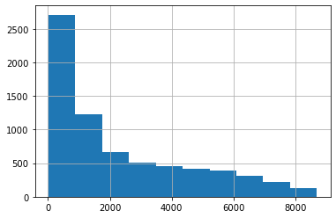
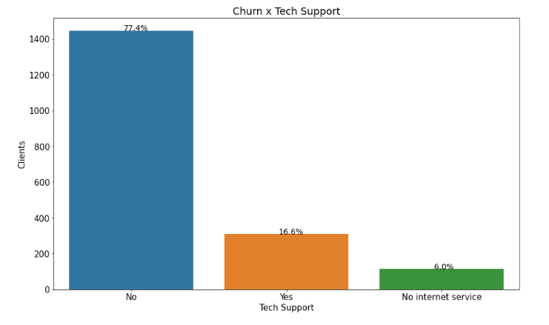
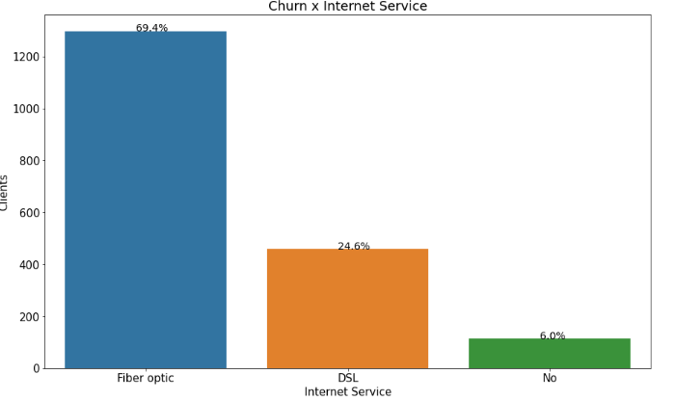
EDA Work & Insights:
Telco Customer Churn Prediction
Data Science Project
Null values Problem :
Total Charges Column was made as object although it has numeric values, so we converted it into numeric.
Then we found that has null values that we filled with median as data distribution was right skewed as the figure in the right show.
Insights
Most of clients had fiber-optic services. Is it possible that the company may have some improvements to make for this kind of service? Or what if these clients are from a region where fiber optic services may be suffering issues? It would be valuable to have region information in this dataset to know where these clients are from.
Clients who left don't sign up for additional services, meaning they're left without tech support, device protection, backup security, etc. This could be a problem if clients are leaving because they don't have tech support to help them with an issue they're facing? Or they've had issues with their devices, and they weren't covered?

Slide 3
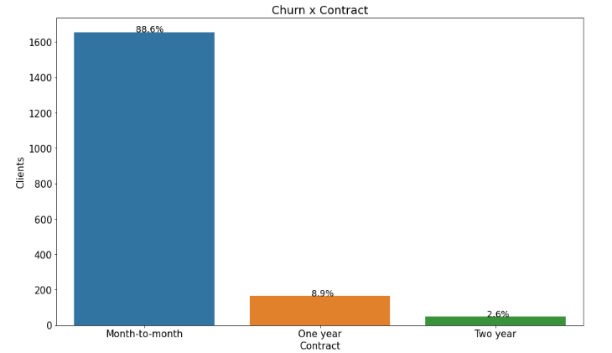
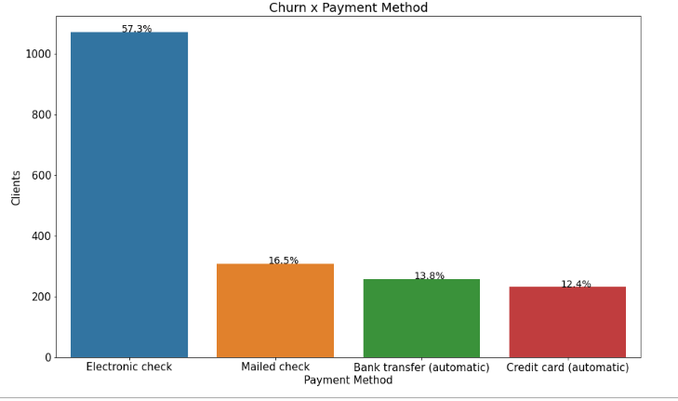
Insights
Telco Customer Churn Prediction
Data Science Project
88.6% of clients are on a month-to-month contract, and that's a huge difference between the proportion of churn clients who were on one-year and two-year contracts. We can see that a month-to-month contract makes it easier for clients to cancel their subscription, so we should offer them benefits to make both the yearly contracts much more appealing than a month-to-month contract
most churn clients were paying with electronic checks as a payment method. do these checks get sent to the right platforms at the right time? Are we having any issues regarding the electronic check payment service?

Slide 4
Customers behavior analysis in each group:
Telco Customer Churn Prediction
Data Science Project
First Group Characteristics:
This cluster has an average tenure of 18 months, indicating relatively newer customers.
The churn rate in this cluster is 32%, which is higher compared to second group but lower than third group.
Customers in this group have lower Monthly Charges and Total Charges compared to the other groups.
They are more likely to have Phone Service, Multiple Lines, and Internet Service.
Online Security, Online Backup, Device Protection, and Tech Support are moderately used services in this group.
Second Group Characteristics:
This group has the highest average tenure of 64 months, indicating long-term customers.
The churn rate in this group is 13.8%, which is the lowest among the three groups.
Customers in this group have higher Monthly Charges and Total Charges compared to the other groups.
They are more likely to have multiple lines, internet services, and additional services like Online Security, Online Backup, Device Protection, and Tech Support.
Most customers in this group have a contract and prefer paperless billing.
Third Group Characteristics:
This group has an average tenure of 44 months.
The churn rate in this group is 22.3%, which is higher compared to second group but lower than first group.
Customers in this group have moderate Monthly Charges and Total Charges.
They are more likely to have Phone Service, Multiple Lines, and Internet Service.
Online Security, Online Backup, Device Protection, and Tech Support are used to a lesser extent in this group compared to first group.

Slide 5
Model Selection and Evaluation Metrics
Telco Customer Churn Prediction
Data Science Project
Model | Accuracy | Precision | Recall | F1_Score
Logistic Regression | 78.35% | 54.77% | 70.98% | 61.83%
Random Forest Classifier | 78.14% | 54.98% | 63.51% | 58.93%
AdaBoost Classifier | 75.59% | 50.40% | 73.28% | 59.72%
Gradient Boosting Classifier | 77.50% | 53.29% | 72.13% | 61.29%
Extra Trees Classifier | 76.79% | 52.62% | 60.63% | 56.34%
Selected multi algorithms like LogisticRegression, RandomForestClassifier, AdaBoost Classifier,
Gradient Boosting Classifier, Extra Trees Classifier
to fit and predict.
Did prediction before feature selection and after
Final Observations
After tuning, we ended up with a tuned Gradient Boosting model with a recall of 77.59% and an F1-score of 62.94% which indicates that the model is performing well in identifying positive instances (churn). This suggests that the model is able to capture a significant portion of Customers that churn correctly while maintaining a reasonable level of precision. Therefore, can be considered as an indicator of a good model performance in the given context.
RandomizedSearchCV Parameter Tuning
Model | Accuracy | Precision | Recall | F1_Score
Logistic Regression | 78.35% | 54.70% | 71.84% | 62.11%
Gradient Boosting Classifier | 77.43% | 52.94% | 77.59% | 62.94%

